Slide 1

University of Rome Tor Vergata
Macroarea di Ingegneria
Master’s Thesis in Energy Engineering
Health-conscious model predictive control for a residential hydrogen-based hybrid renewable energy system
Advisor
Prof. Lorenzo Bartolucci
Candidate
Federico Donato
09-06-2022
Academic Year 2020/2021

Slide 2



Italian energy context
Piano Nazionale Integrato per l’Energia ed il Clima - PNIEC
180 Mld€
Cumulative investments with the «PNIEC scenario»
30%
Target of renewable energy share in the final consumption
+54%
+53%
+30 GW
-7 Mtep
Reduction of emissions and consumptions in the residential sector
Growth of photovoltaic

Slide 3
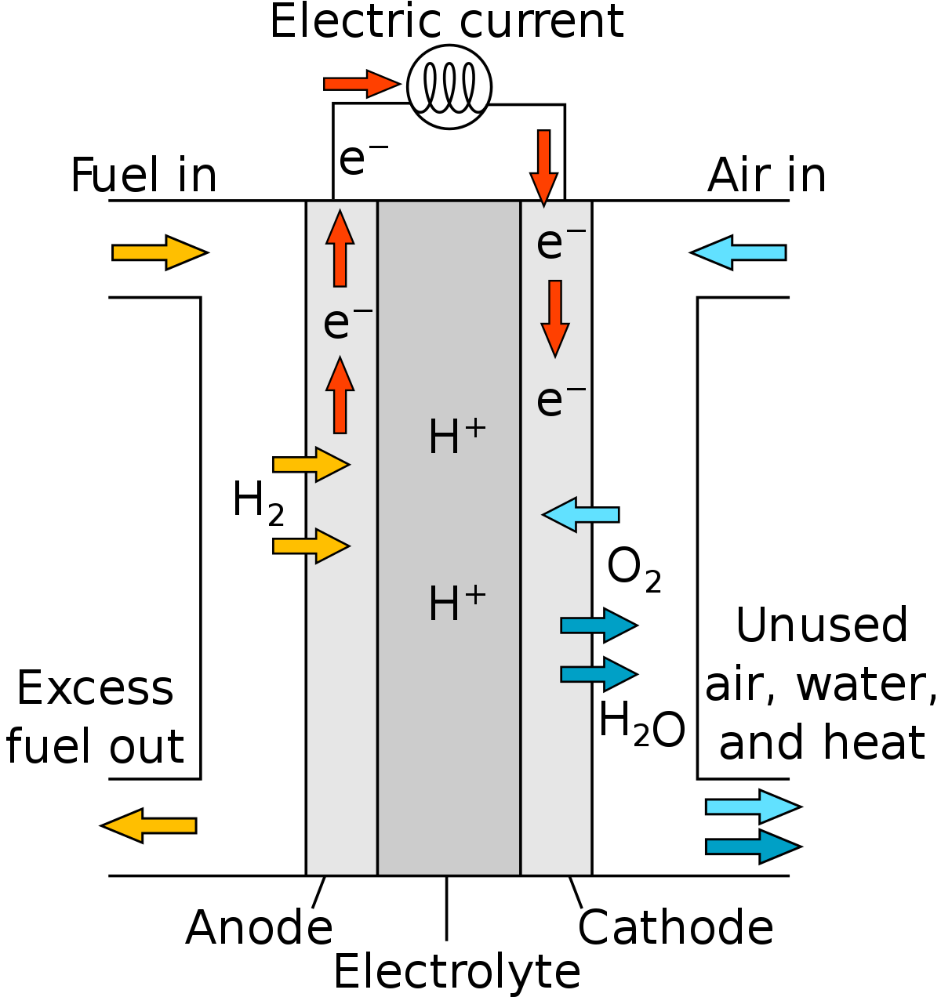
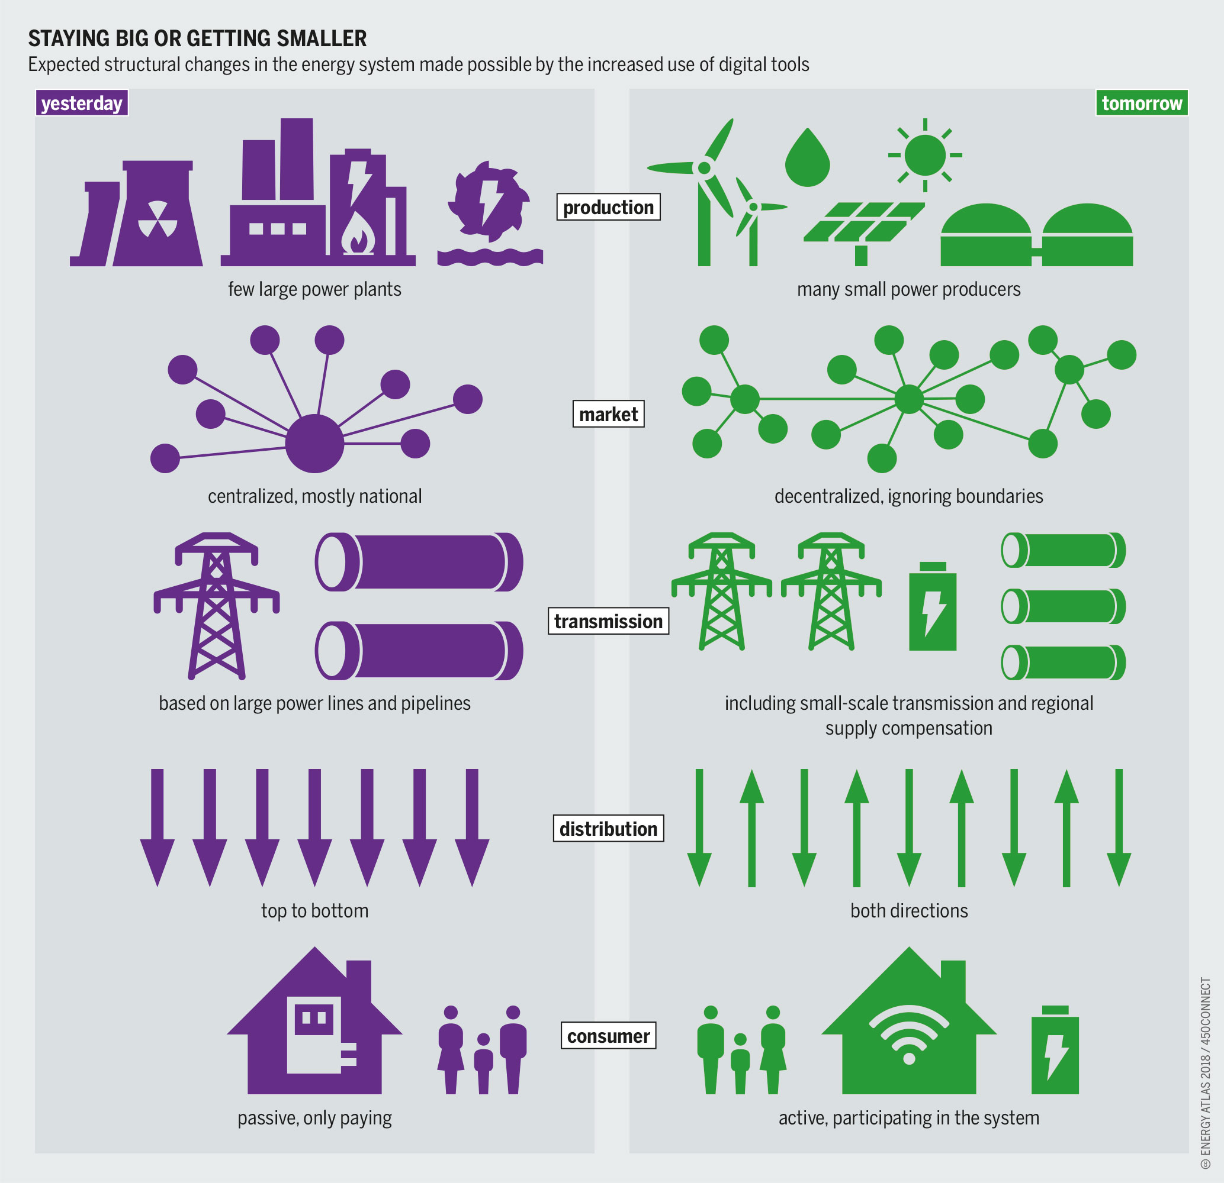


Hydrogen, Distributed Generation and Smart Grid
2.4
Greater mass energy density than natural gas
$$H_{2}O$$
No GHG emissions, just water
≤60%
High energy conversion efficiency
Wikipedia, “Proton-exchange membrane fuel cell”
359
Large-scale projects announced by the EU
435 Mld€
Planned investments to 2030
10 Mton
Expected hydrogen production to 2030 (70% green, 30% blue)*
IRENA (2020), “Green Hydrogen Cost Reduction: Scaling up Electrolysers to Meet the 1.5⁰C Climate Goal”
Bartz, Stockmar, «Staying big or getting smaller», Energy Atlas 2018: Figures and Facts about renewables in Europe
(*) Volano gli investimenti nell'idrogeno, l'astro nascente della transizione energetica - LifeGate

Slide 4

Power grid digitalization
Penetration of renewable sources in the energy mix
Ecological transition and energy communities
Distributed generation and smart grid
Prosumers and bidirectional power flows
Data-driven approach and machine learning
Batteries and storage systems
Predictive Maintenance
Hydrogen and fuel cells
Health Management
Stability and flexibility
Fastness and resilience
Digitalize power and industrial grid - Digital grid - Iskra
Upgrade in the role of TSO & DSO
Control algorithms and forecast systems
Real-time monitoring

Slide 5
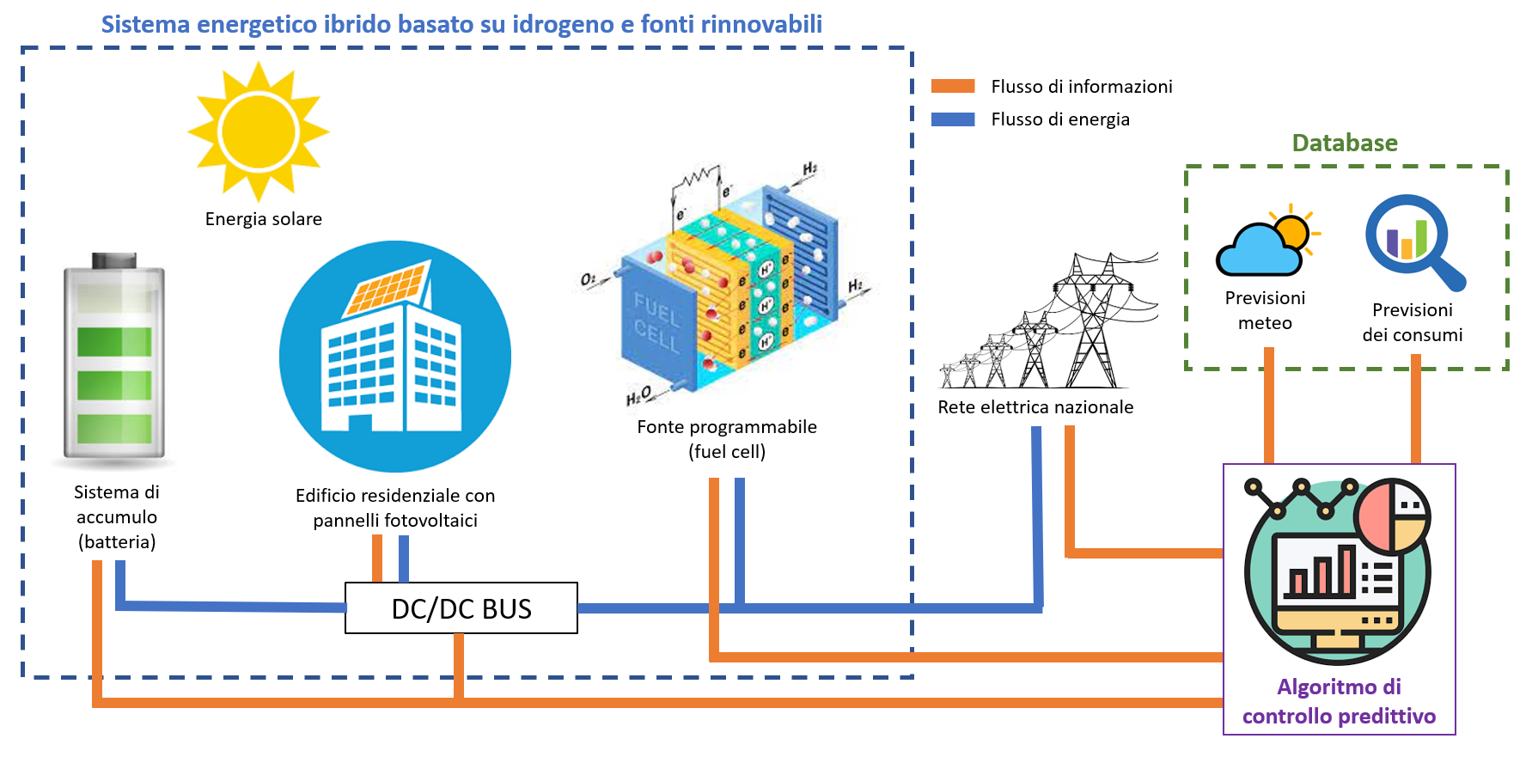




Target
Development of a novel model predictive control system for a hydrogen-based on-grid hybrid renewable energy system for residential purposes
Objective of increased penetration of renewable energies in the energy mix and resilience
Objective of health-management
Linear programming model
Design parameters:
Grid fastness
OPEX
Matlab
Simulink
YALMIP

Slide 6
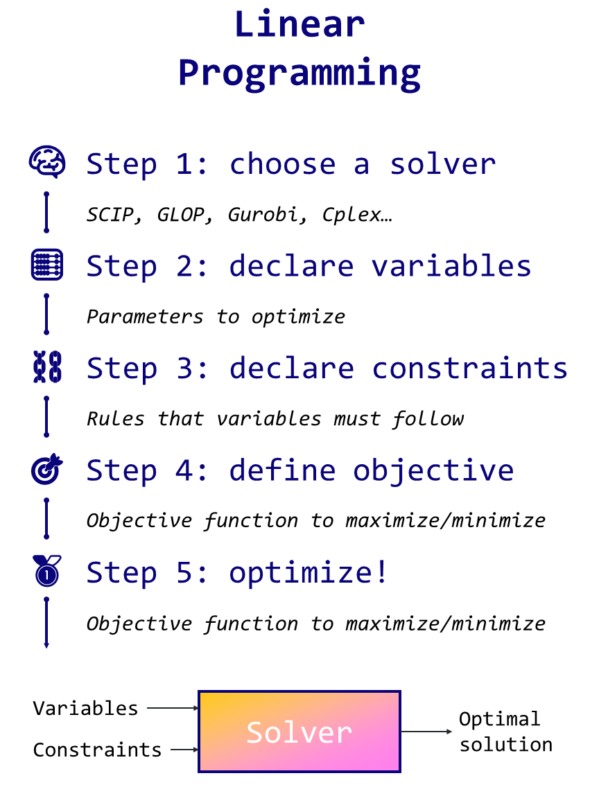

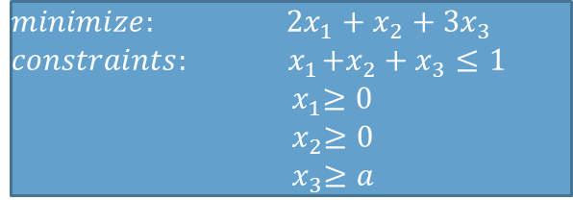
Linear programming algorithms in YALMIP code
Parameters: data of the optimization problem
YALMIP code
Decision variables: variables to act on in order to determine the optimal outcome
sdpvar
solver
Constraints
Options
Constraints: mathematical (in)equalities to define the feasible region
Objective function: mathematical expression to maximize or minimize
Objective
Optimize
Mixed Integer Linear Programming (MILP)
Decision variables can assume both integer or real values
Introduction to Linear Programming in Python | Towards Data Science
$$minimize: 2x_{1}+x_{2}+3x_{3}$$
$$constraints:{ x}_{1}+x_{2}+x_{3}≤1 \\ { x}_{1}≥0 \\ { x}_{2}≥0 \\ { x}_{3}≥a$$
Canonical form of a linear programming model
yalmip.github.io

Slide 7
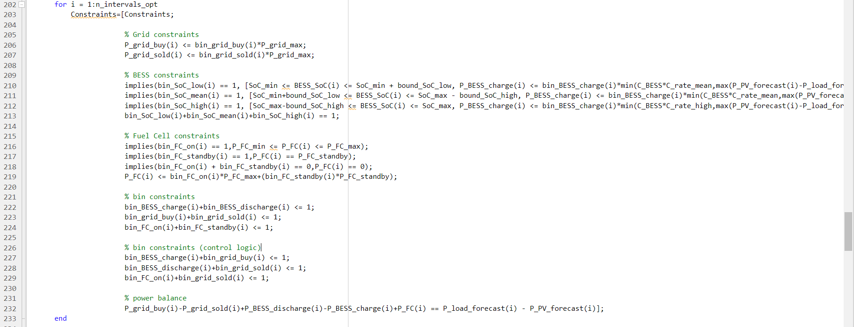
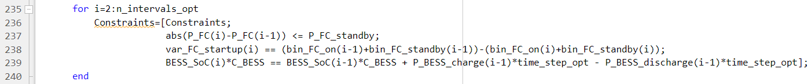
Control system
Grid: max power
Fuel cell: 3-state operating region
Battery: SoC-dependent charge and discharge power
Binary variables: modellazione della logica di controllo desiderata
Instantaneous power balance
Constraints on max fuel cell power rate, min number of startups and SoC definition

Slide 8
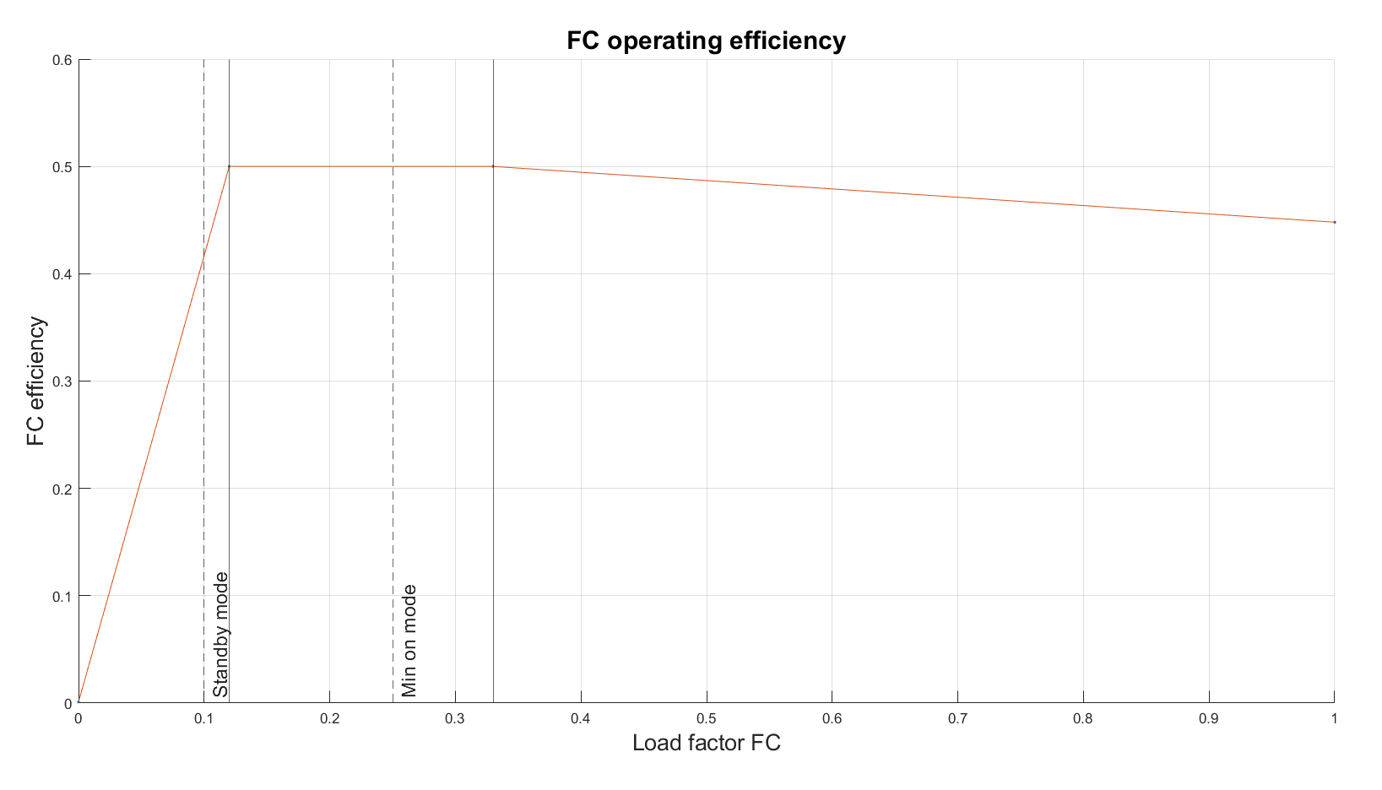
Control system
Piece-wise linearization of fuel cell’s operating efficiency, in order to address non-linear effects related to fuel cell operating points
Plateau region (mean load factor)
Falling region (high load factor)
Simulation parameters
Simulation Time | 7 days
Actual simulation length | ≈ 11 hours
Time horizon | 2 days
Solver | Gurobi
Controllers | 3 (2 MPC + 1 DP)
Initial simulations | 3
Further analysis | 2
Rising region(low load factor)

Slide 9
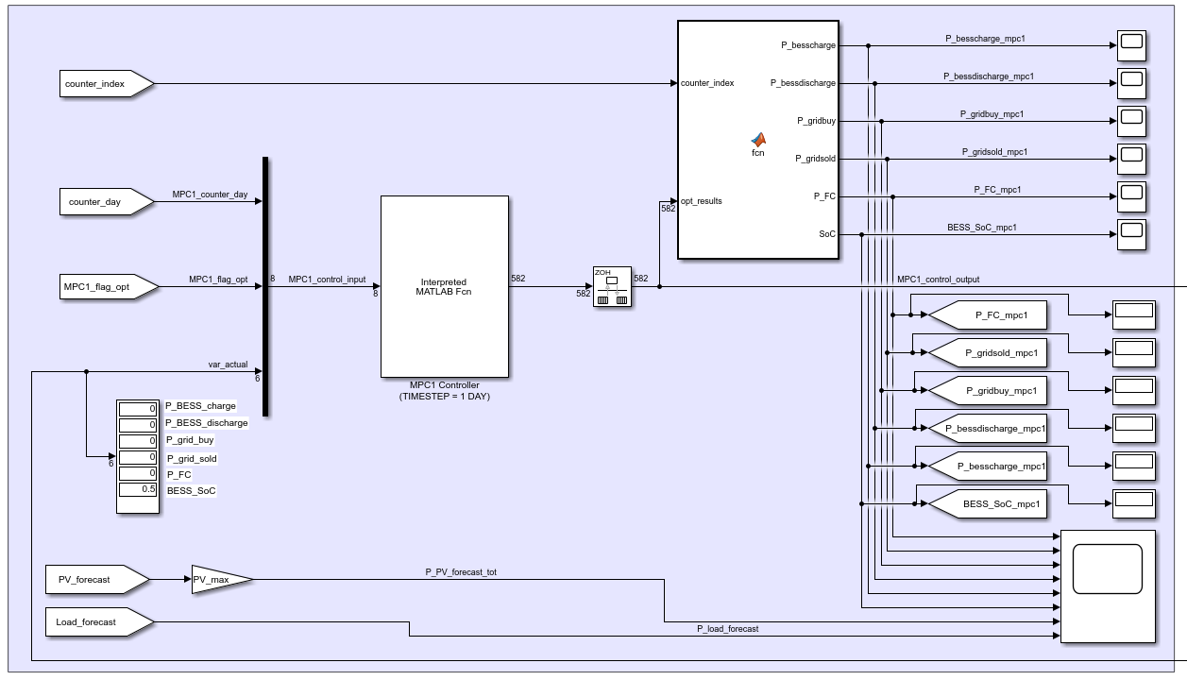
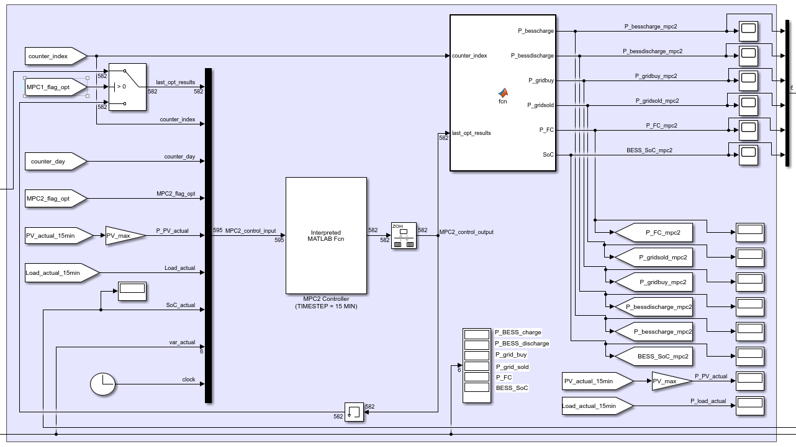
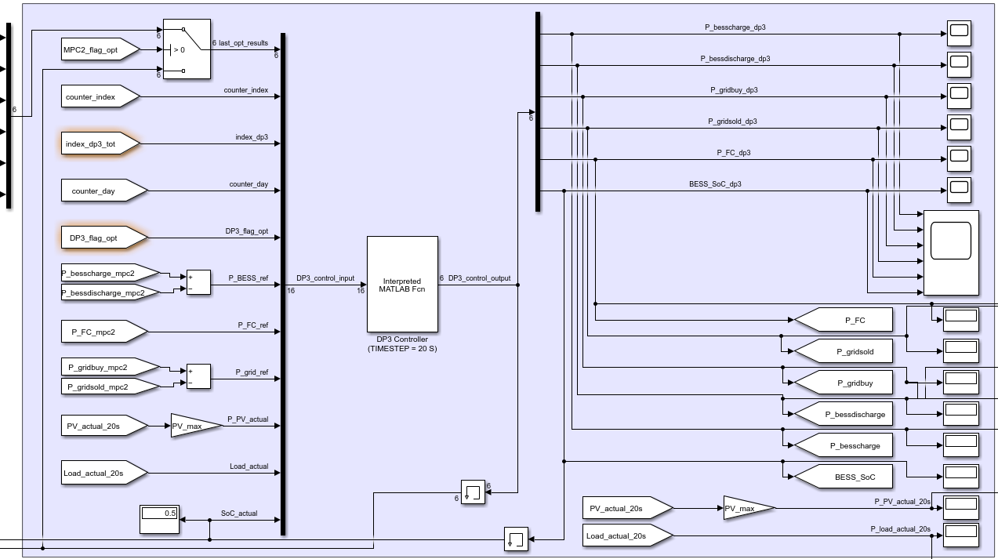




Control system
1° controller – MPC1
2° controller – MPC2
3° controller – DP3
OPEX
OPEX & $Δ_{{grid}_{MPC1}}$
$$Δ_{MPC2}$$
Time horizon: 2 days
Optimization time step: 1 day
Time horizon: 2 days
Optimization time step: 15 minutes
Optimization time step: 20 seconds
Forecast data (weather + residential load)
Forecast & actual data (weather + residential load)
Actual data (weather + residential load)
Reference grid exchange profile
Updated grid exchange profile
Real-time control actions
Dispatching (DSO), grid fastness and reliable integration of produced renewable energy
Penalty of the energy unbalance exchanged with the grid
Penalty of energy profile deviation of battery, fuel cell and grid

Slide 10
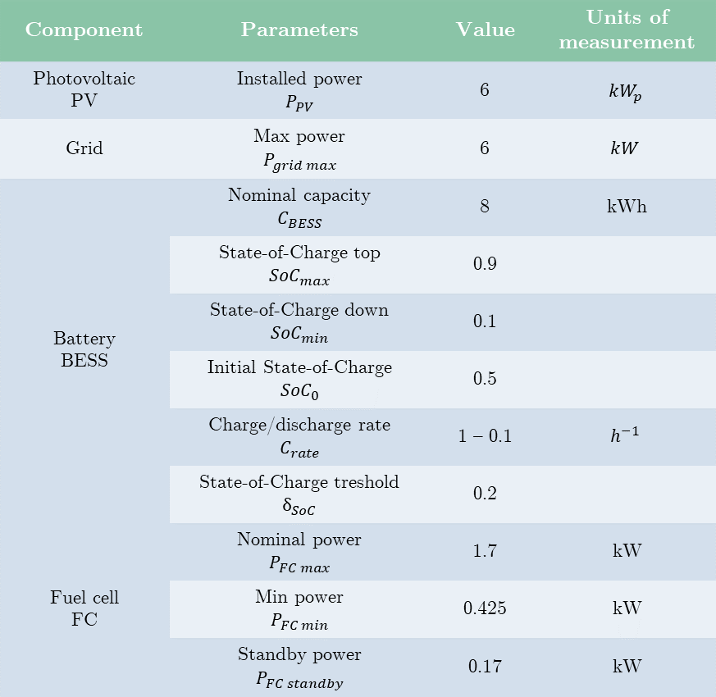
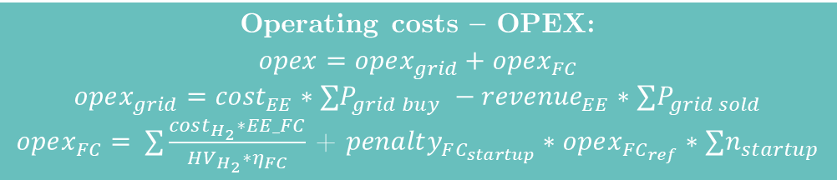
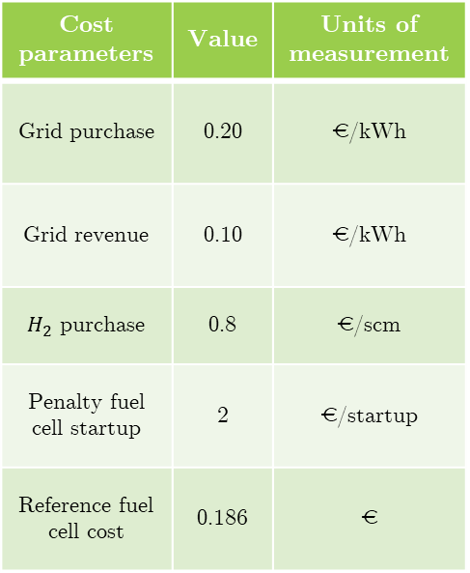
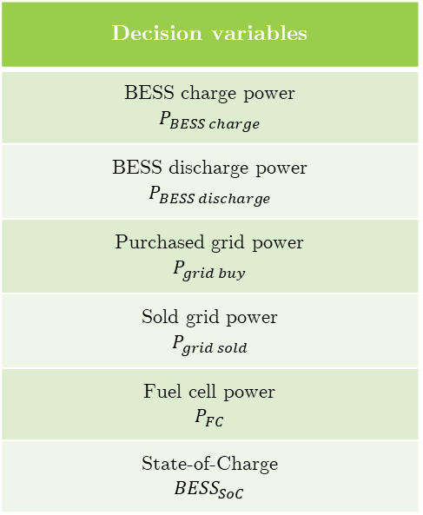
Control system
Component | Parameters | Value | Units of measurement
Photovoltaic PV | Installed power $$P_{PV}$$ | 6 | $${kW}_{p}$$
Grid | Max power $$P_{grid max}$$ | 6 | $$kW$$
Battery BESS | Nominal capacity $$C_{BESS}$$ | 8 | kWh
 | State-of-Charge top $${SoC}_{max}$$ | 0.9
 | State-of-Charge down $${SoC}_{min}$$ | 0.1
 | Initial State-of-Charge $${SoC}_{0}$$ | 0.5
 | Charge/discharge rate $$C_{rate}$$ | 1 – 0.1 | $$h^{−1}$$
 | State-of-Charge treshold $$δ_{SoC}$$ | 0.2
Fuel cell FC | Nominal power $$P_{FC max}$$ | 1.7 | kW
 | Min power $$P_{FC min}$$ | 0.425 | kW
 | Standby power $$P_{FC standby}$$ | 0.17 | kW
Decision variables
BESS charge power $$P_{BESS charge}$$
BESS discharge power $$P_{BESS discharge}$$
Purchased grid power $$P_{grid buy}$$
Sold grid power $$P_{grid sold}$$
Fuel cell power $$P_{FC}$$
State-of-Charge $${BESS}_{SoC}$$
Cost parameters | Value | Units of measurement
Grid purchase | 0.20 | €/kWh
Grid revenue | 0.10 | €/kWh
$H_{2}$ purchase | 0.8 | €/scm
Penalty fuel cell startup | 2 | €/startup
Reference fuel cell cost | 0.186 | €
Operating costs – OPEX:
$$opex=opex_{grid}+opex_{FC}$$
$$opex_{grid}={cost}_{EE}∗∑P_{grid buy} −{revenue}_{EE}∗∑P_{grid sold}$$
$opex_{FC}= ∑\frac{cost_{H_{2}}∗EE_FC}{HV_{H_{2}}∗η_{FC}}$ + $penalty_{FC_{startup}}∗opex_{FC_{ref}}∗∑n_{startup}$

Slide 11
Results introduction
KEY PERFORMANCE INDICATOR
Up to a certain degree of error, the system is still able to contain the deviation of the actual grid exchange profile to acceptable levels
If the error is too high, the system can no longer dampen deviations and therefore tends to act on the grid profile, penalising the energy unbalance exchanged with the grid
Energy unbalance: deviation between actual exchange with the grid and the reference profile reported at the beginning of the day [kWh].
The predictive control system can efficiently minimize the energy unbalance with the grid compared to the reference provided at the start of the day
Trend of cumulative energy exchanged with the grid
Unbalance power trend with reference to specific time targets

Slide 12
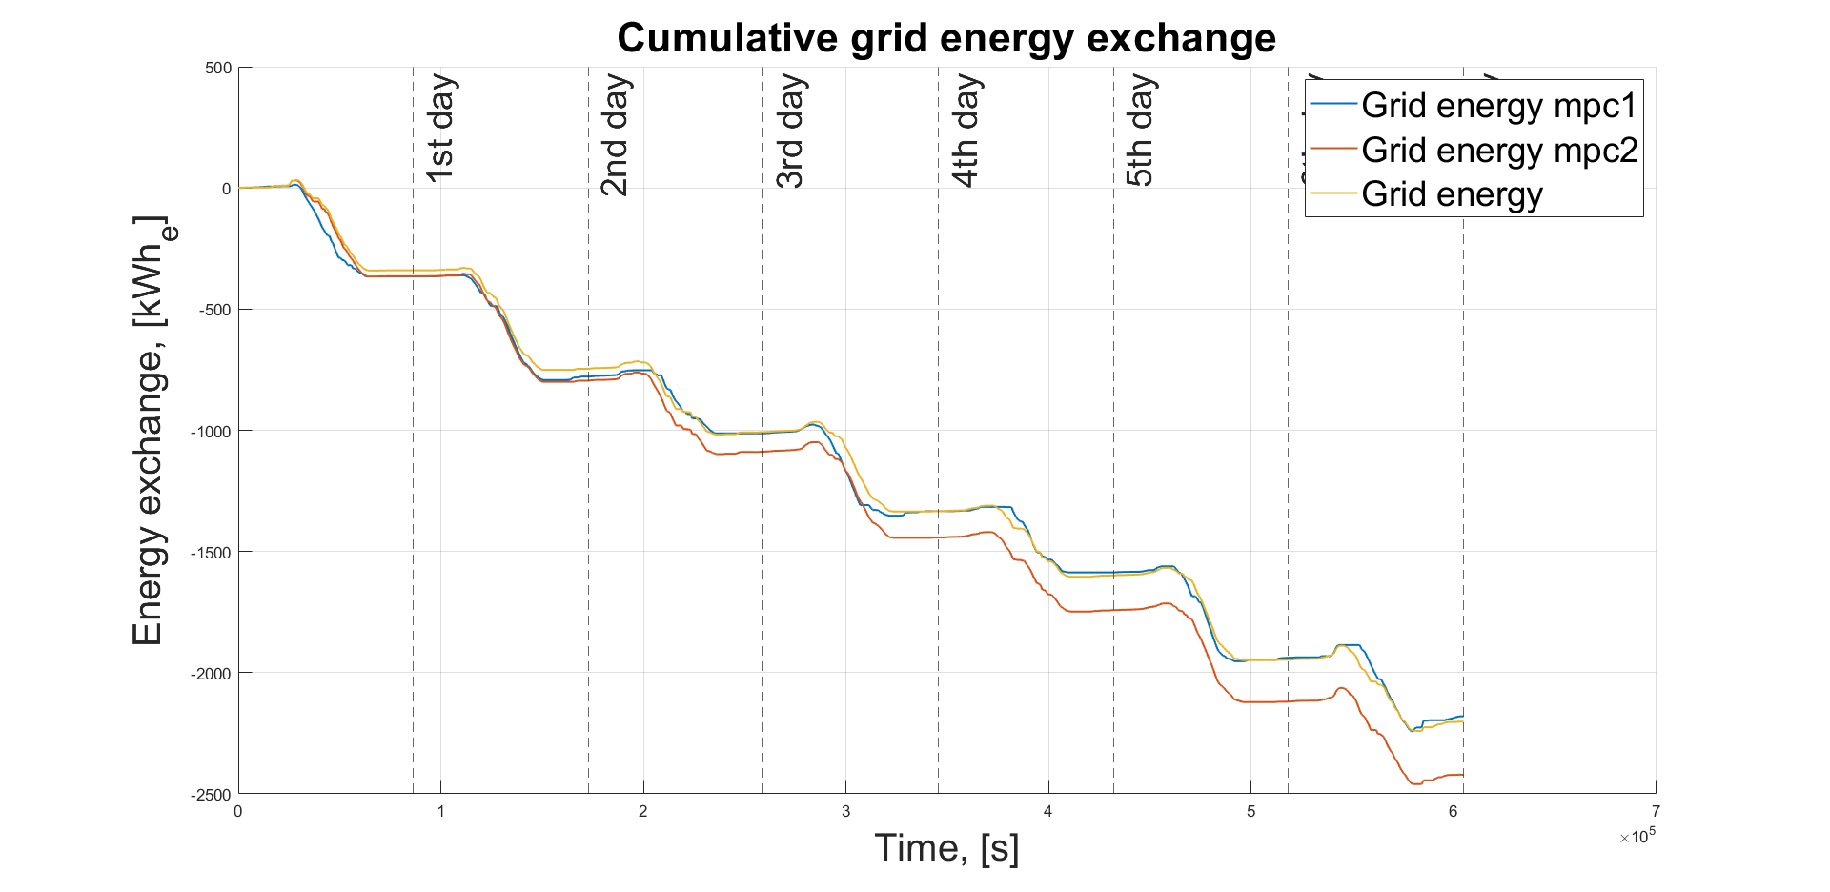
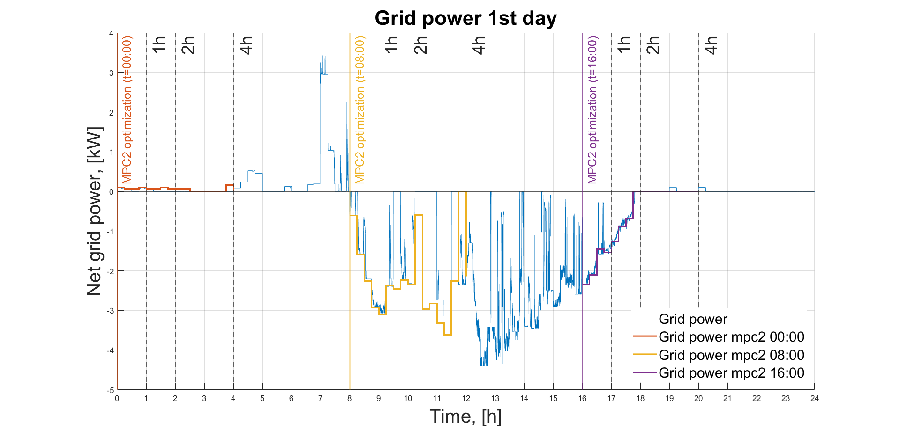
Performance trend as a function of forecast error
1° CASE: PERFECT FORECAST
Convergence between reference and actual profile
Actual weather and load data have small deviations (± 5%) compared to the average value correctly provided by forecasts
0.015
Root mean square error (RMSE)
The fuel cell interventions are minimal and undemanding, so the control succeeds in maxing out the average operating efficiency
0.486
Average fuel cell operating efficiency
Predictive control performance: cumulative energy exchanged with the grid
3.241
Daily average energy unbalance
[kWh/d]
The system succeeds in excellently minimizing energy unbalance exchanged with the grid
Control efficiency for time targets ≥ 15 mins
Predictive control performance: unbalance power with 1-, 2- and 4-hour targets

Slide 13
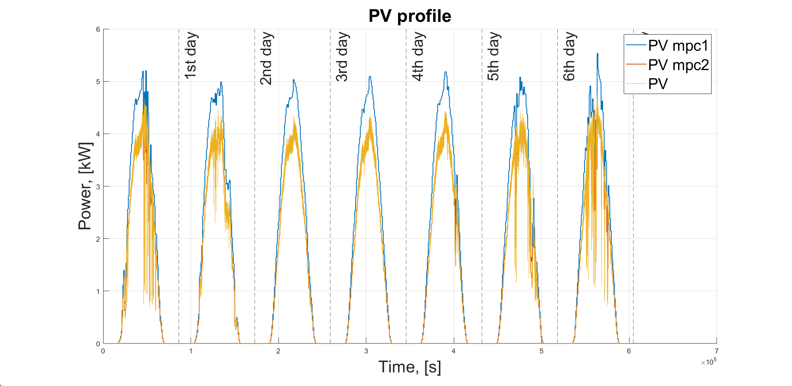
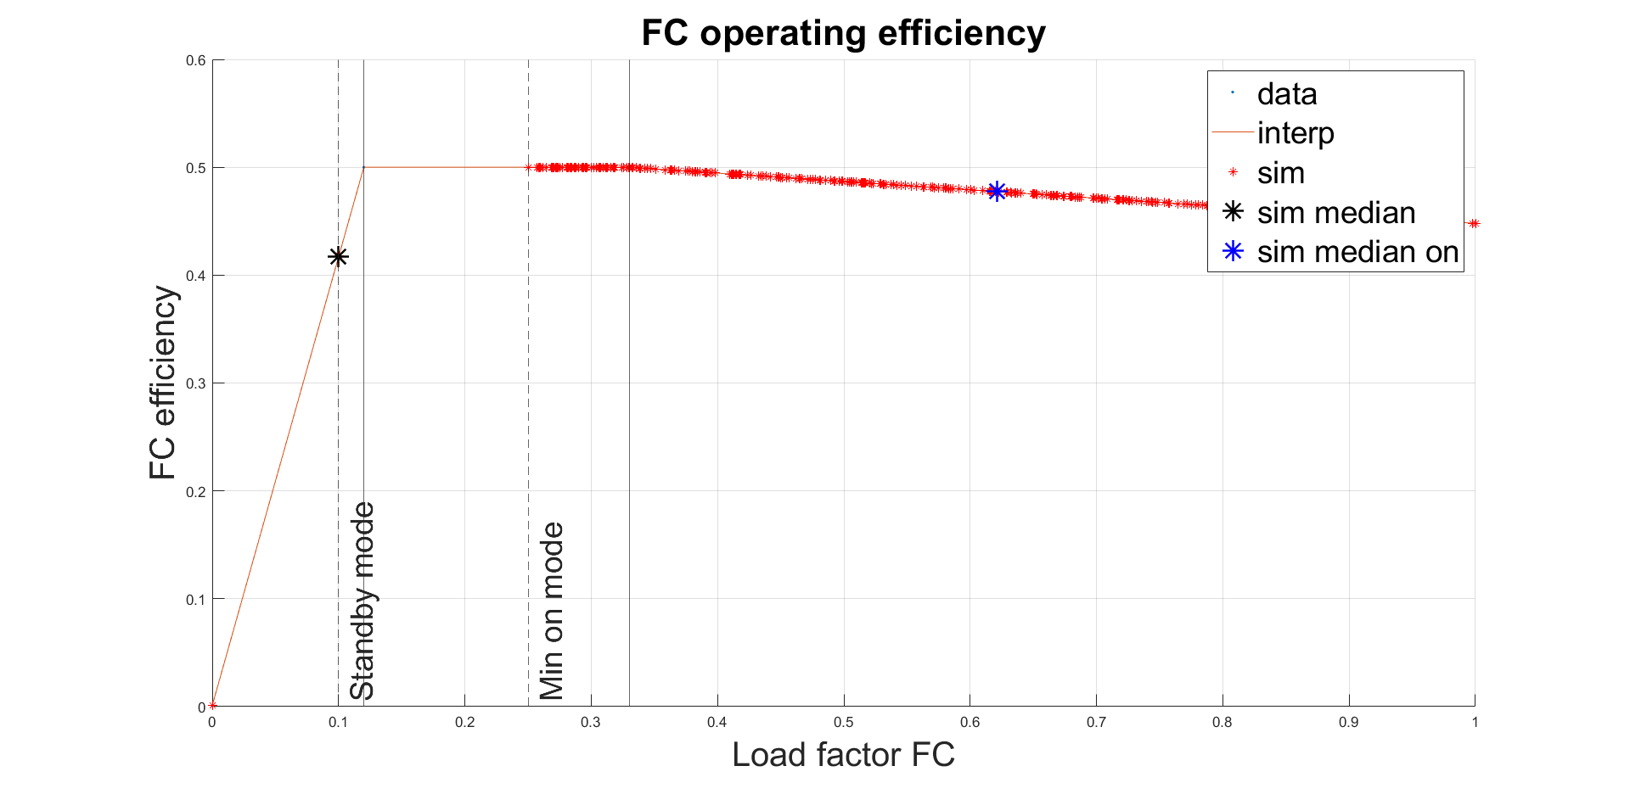
Performance trend as a function of forecast error
2° CASE: ACCEPTABLE FORECAST
The average predicted energy from photovoltaics is overestimated compared to actual values, while the actual load is overlapped to the predicted load
0.248
Root mean square error (RMSE)
Actual PV always lower than expected
The fuel cell works at a higher average load factor to compensate energy for unexpected photovoltaic fluctuations
0.477
Average fuel cell operating efficiency
Simulation hypothesis: generation profile from photovoltaics
138.7
Daily average energy unbalance
[kWh/d]
The system struggles to contain the unbalance energy due to the significantly incorrect forecast system
Trade-off between max efficiency and max power
Predictive control performance: fuel cell operating points

Slide 14
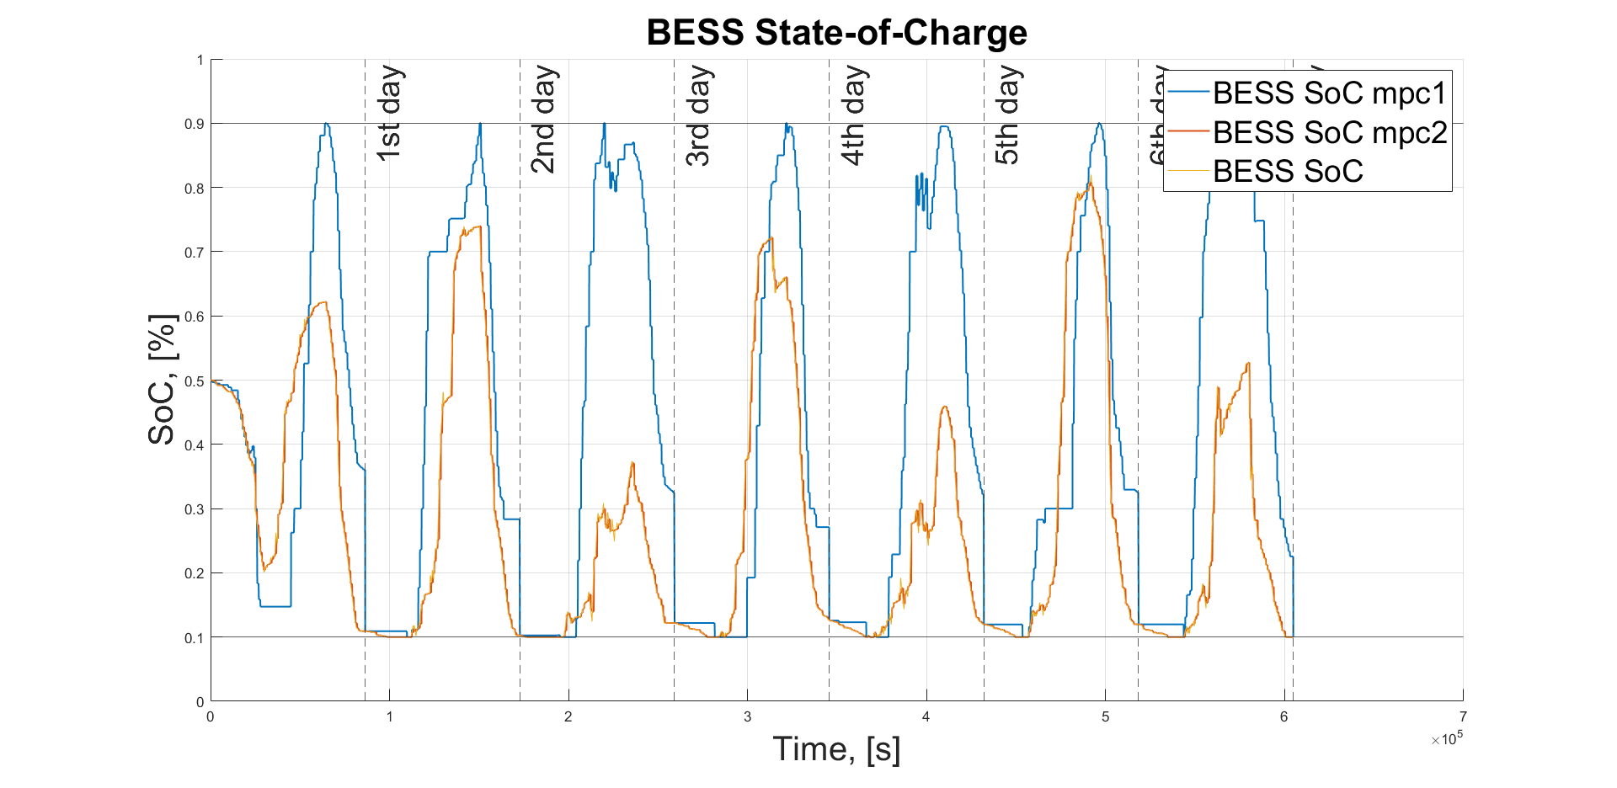
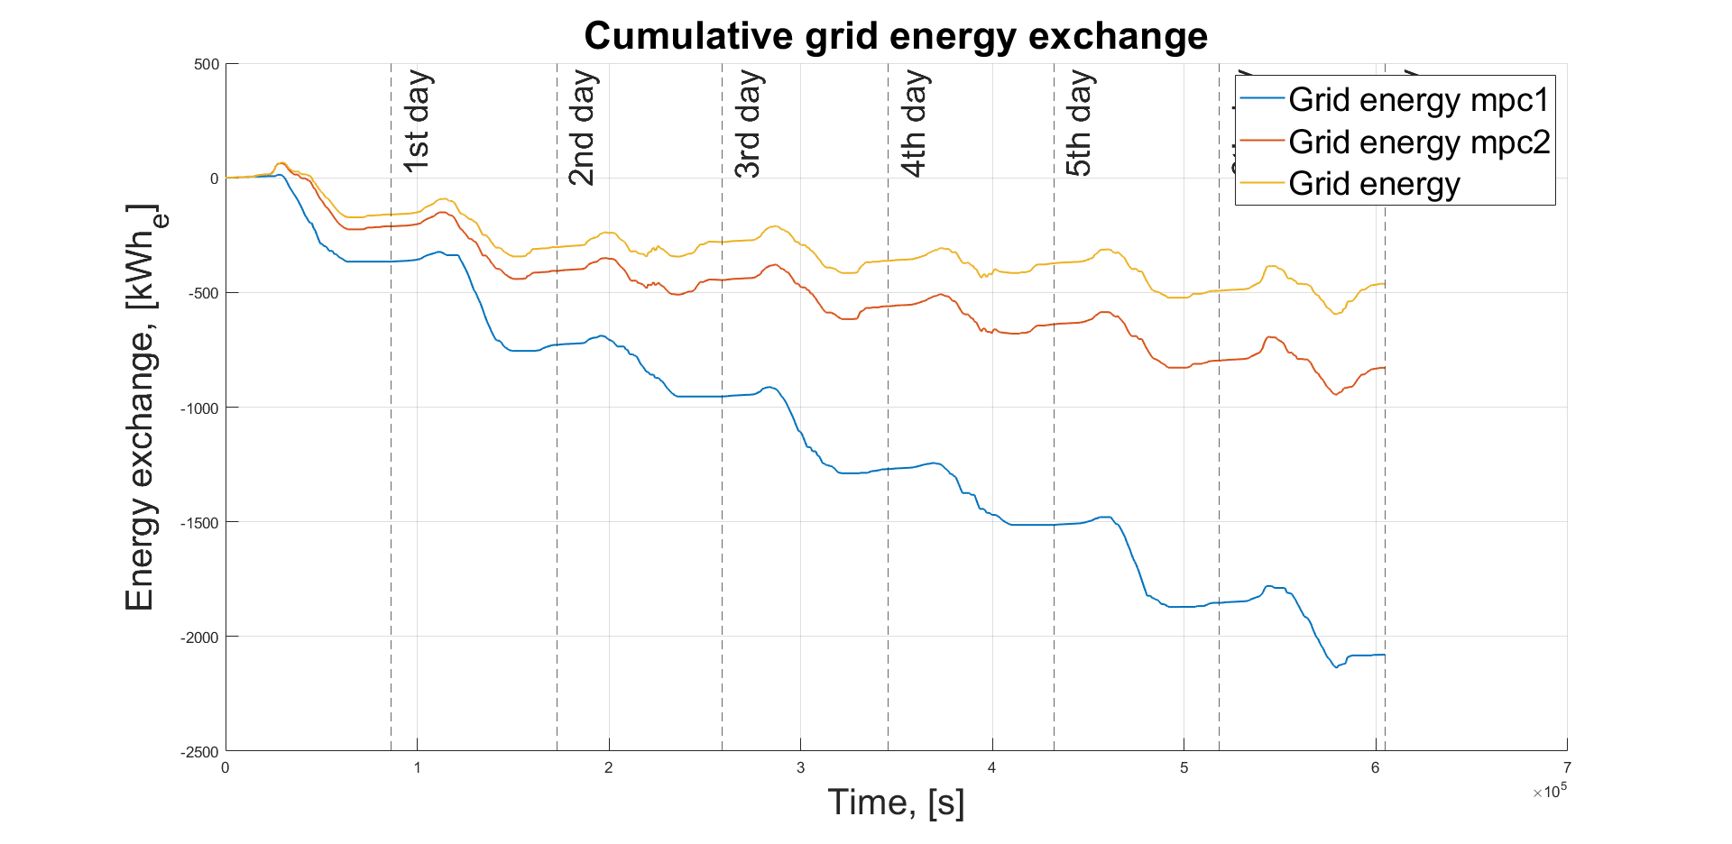
Performance trend as a function of forecast error
3° CASE: INCORRECT FORECAST
The battery acts heavily to cover fluctuations
The forecast are at the same time incorrect and penalising, i.e. the actual PV is less than expected and the actual load is greater than expected
0.394
Root mean square error
(RMSE)
The fuel cell is most often found working in standby conditions, resulting in a high average operating efficiency
0.488
Average fuel cell operating efficiency
Predictive control performance: battery State-of-Charge profile
230.9
Daily average energy unbalance
[kWh/d]
The control cannot guarantee sufficient performance in terms of energy unbalance with the grid
The actual profile diverges from the reference profile already from the first day of simulation
Predictive control performance: cumulative energy exchanged with the grid

Slide 15
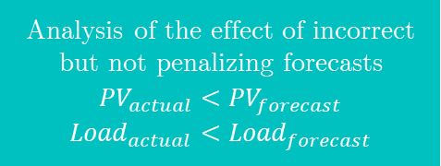
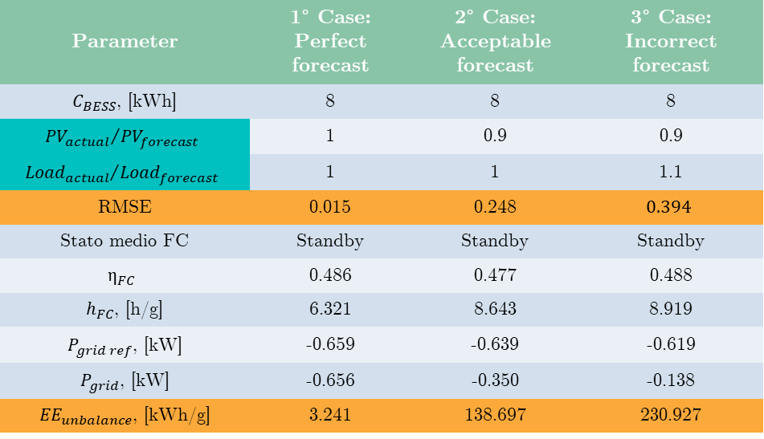
Performance trend as a function of forecast error
Parameter | 1° Case: Perfect forecast | 2° Case: Acceptable forecast | 3° Case: Incorrect forecast
$C_{BESS}$, [kWh] | 8 | 8 | 8
$${{PV}_{actual}}/{{PV}_{forecast}}$$ | 1 | 0.9 | 0.9
$${{Load}_{actual}}/{{Load}_{forecast}}$$ | 1 | 1 | 1.1
RMSE | 0.015 | 0.248 | $$0.394$$
Stato medio FC | Standby | Standby | Standby
$$η_{FC}$$ | 0.486 | 0.477 | 0.488
$h_{FC}$, [h/g] | 6.321 | 8.643 | 8.919
$P_{grid ref}$, [kW] | -0.659 | -0.639 | -0.619
$P_{grid}$, [kW] | -0.656 | -0.350 | -0.138
${EE}_{unbalance}$, [kWh/g] | 3.241 | 138.697 | 230.927
-94%
+59%
-97%
+66%
2° CASE ACCEPTABLE FORECAST
Analysis of the effect of incorrect but not penalizing forecasts
$${PV}_{actual}<{PV}_{forecast}$$
$${Load}_{actual}<{Load}_{forecast}$$
3° CASE INCORRECT FORECAST
Further analysis
1° CASE PERFECT FORECAST
Performance as a function of battery capacity
8 kWh 12 kWh 16 kWh

Slide 16
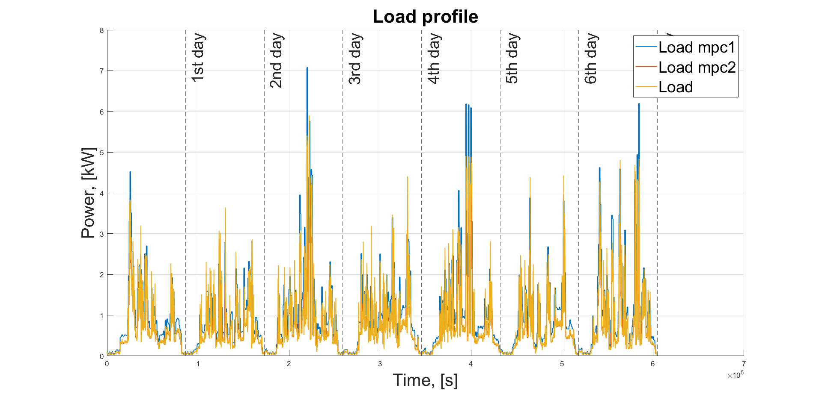
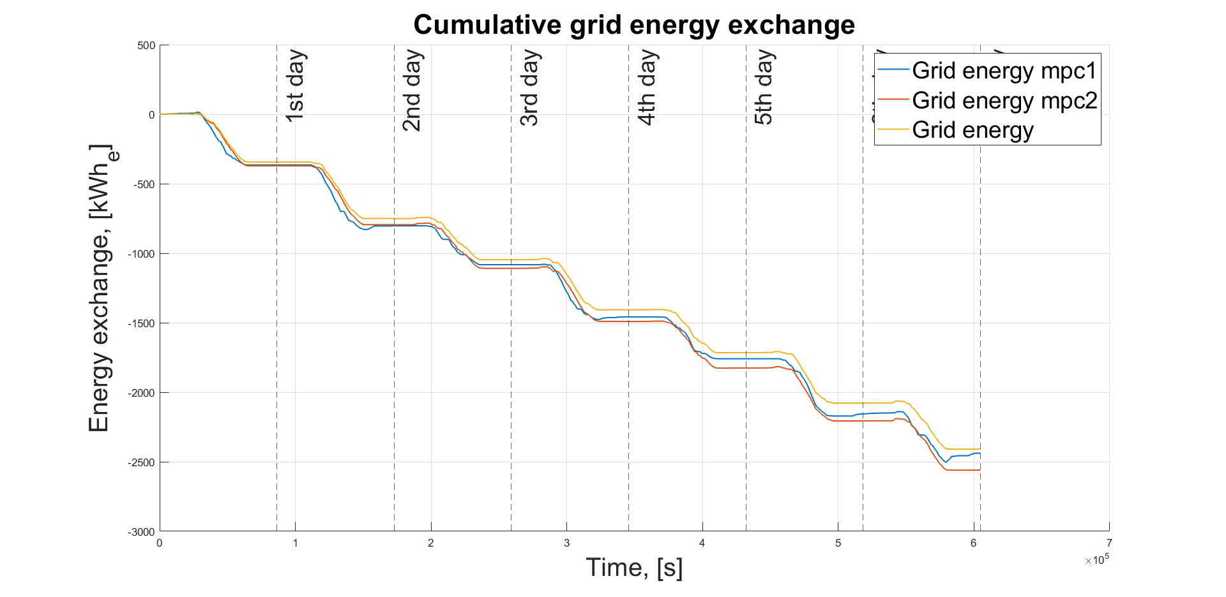
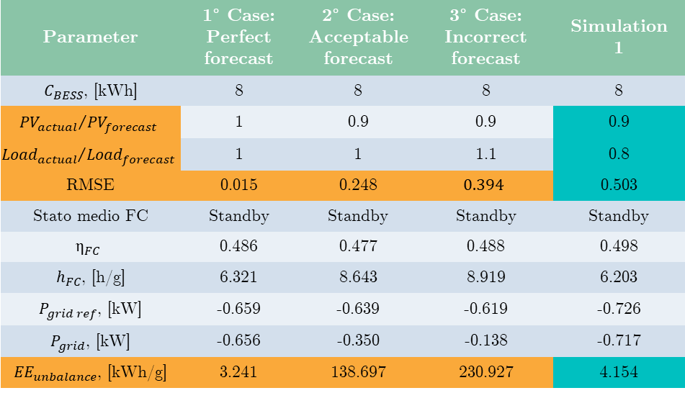
Effect of incorrect but not penalizing forecasts
Parameter | 1° Case: Perfect forecast | 2° Case: Acceptable forecast | 3° Case: Incorrect forecast | Simulation 1
$C_{BESS}$, [kWh] | 8 | 8 | 8 | 8
$${{PV}_{actual}}/{{PV}_{forecast}}$$ | 1 | 0.9 | 0.9 | 0.9
$${{Load}_{actual}}/{{Load}_{forecast}}$$ | 1 | 1 | 1.1 | 0.8
RMSE | 0.015 | 0.248 | $$0.394$$ | 0.503
Stato medio FC | Standby | Standby | Standby | Standby
$$η_{FC}$$ | 0.486 | 0.477 | 0.488 | 0.498
$h_{FC}$, [h/g] | 6.321 | 8.643 | 8.919 | 6.203
$P_{grid ref}$, [kW] | -0.659 | -0.639 | -0.619 | -0.726
$P_{grid}$, [kW] | -0.656 | -0.350 | -0.138 | -0.717
${EE}_{unbalance}$, [kWh/g] | 3.241 | 138.697 | 230.927 | 4.154
Simulation hypothesis: load profile
The best performance is not only achievable under perfect forecasting conditions, since the predictive control system manages to ensure optimal results even in situations of high but not penalizing error
+103%
Increase in RMSE compared to
2° case
Excellent convergence between real profile and reference: the control works well!
-97%
Energy unbalance reduction compared to 2° case
Predictive control performance: cumulative energy exchanged with the grid

Slide 17
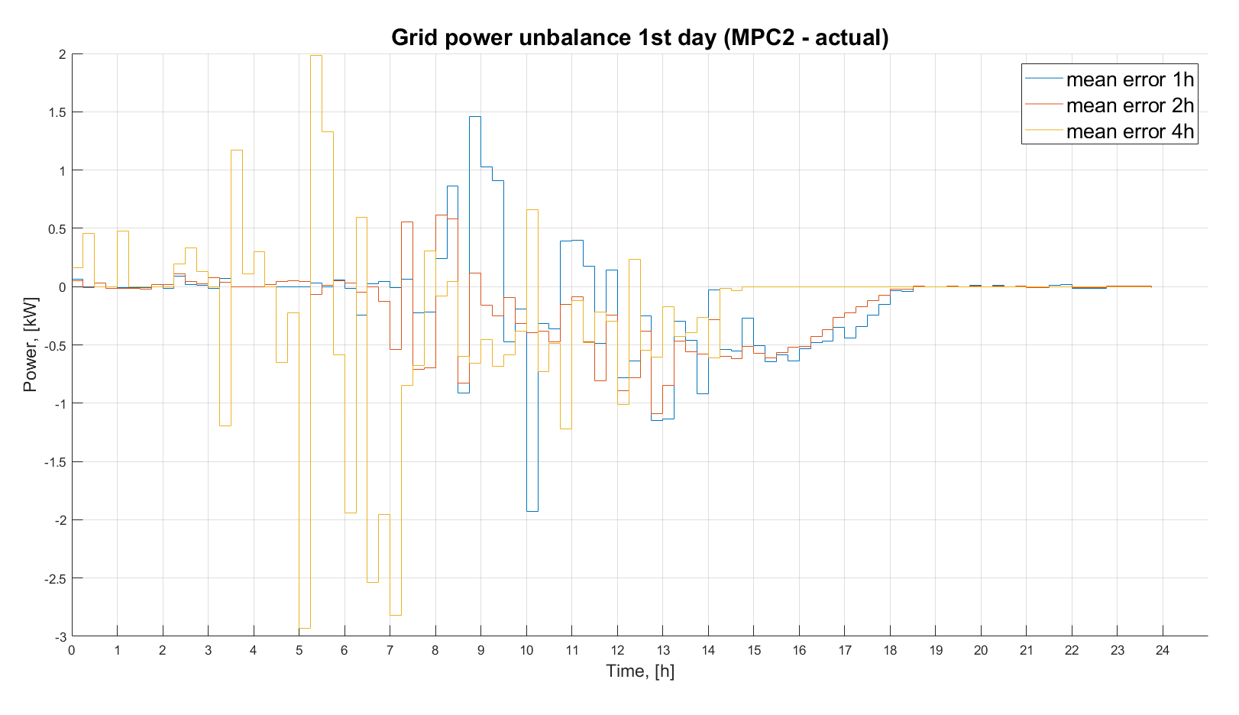
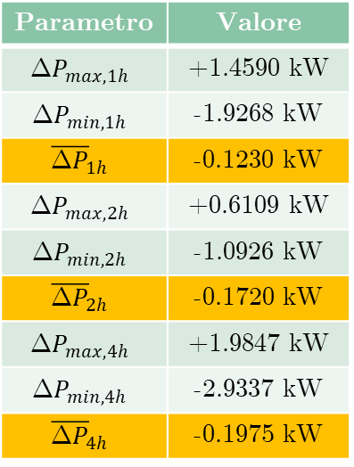
Unbalance power considerations resulting from MPC2 update
Parametro | Valore
$${\text{Δ}P}_{max,1h}$$ | +1.4590 kW
$${\text{Δ}P}_{min,1h}$$ | -1.9268 kW
$${\overline{\text{Δ}P}}_{1h}$$ | -0.1230 kW
$${\text{Δ}P}_{max,2h}$$ | +0.6109 kW
$${\text{Δ}P}_{min,2h}$$ | -1.0926 kW
$${\overline{\text{Δ}P}}_{2h}$$ | -0.1720 kW
$${\text{Δ}P}_{max,4h}$$ | +1.9847 kW
$${\text{Δ}P}_{min,4h}$$ | -2.9337 kW
$${\overline{\text{Δ}P}}_{4h}$$ | -0.1975 kW
+39.8%
+60.6%
More noticeable mid-day deviations (combined presence of pv and load)
The average error of MPC2 optimizations is strongly penalized as the time target increases
Influence of the chosen time step on the grid profile error reported to the DSO

Slide 18
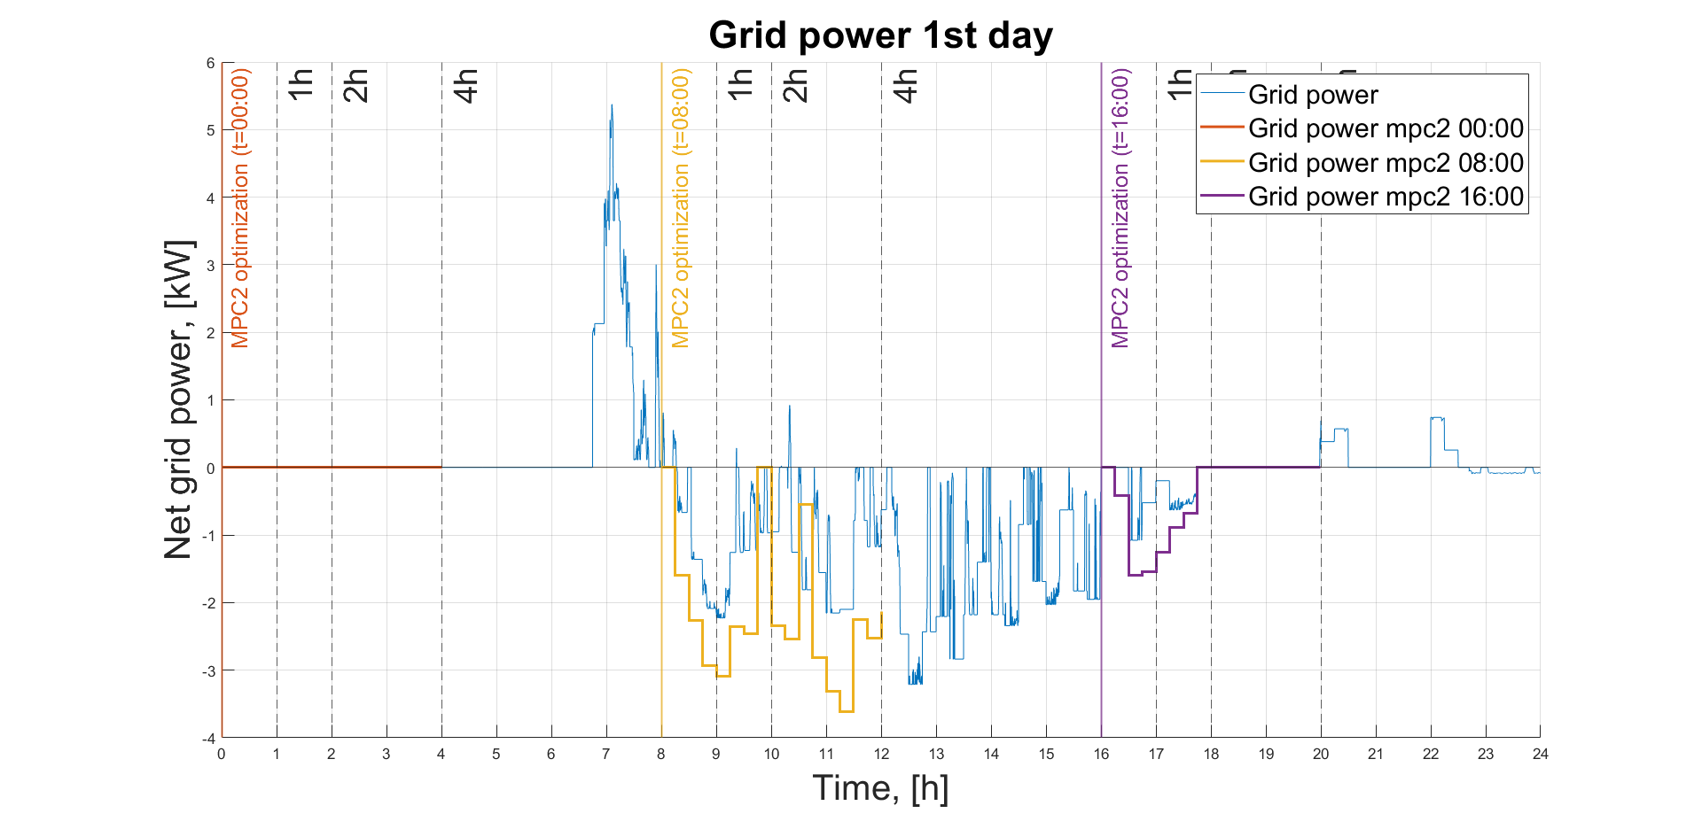
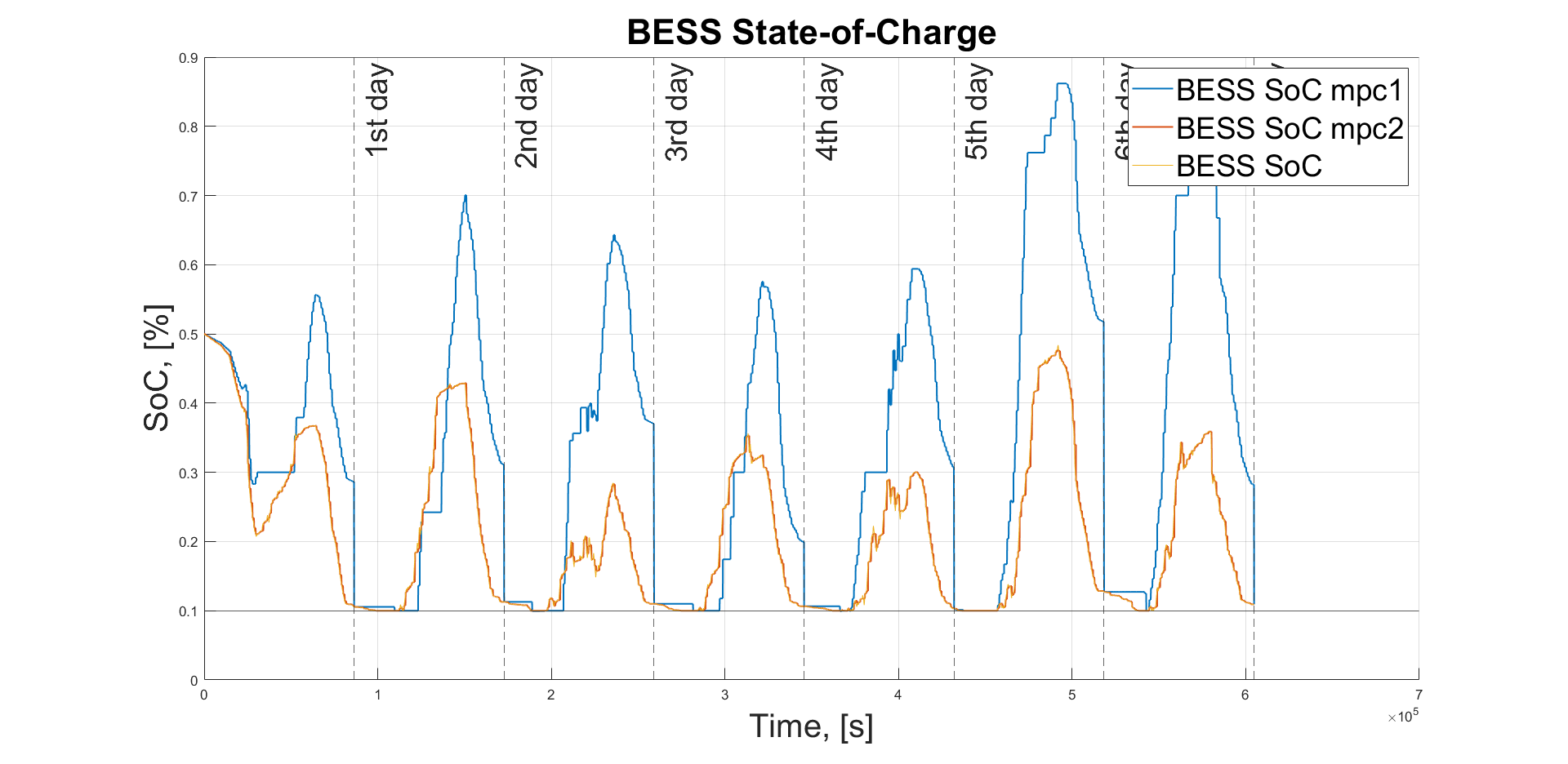
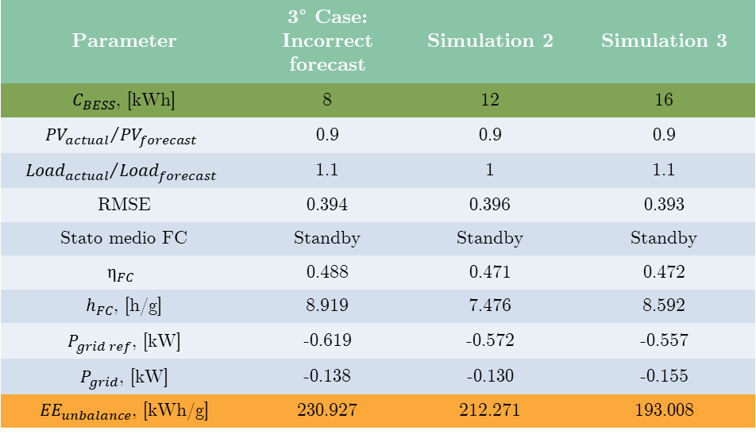
Effect of battery capacity
Parameter | 3° Case: Incorrect forecast | Simulation 2 | Simulation 3
$C_{BESS}$, [kWh] | 8 | 12 | 16
$${{PV}_{actual}}/{{PV}_{forecast}}$$ | 0.9 | 0.9 | 0.9
$${{Load}_{actual}}/{{Load}_{forecast}}$$ | 1.1 | 1 | 1.1
RMSE | 0.394 | 0.396 | 0.393
Stato medio FC | Standby | Standby | Standby
$$η_{FC}$$ | 0.488 | 0.471 | 0.472
$h_{FC}$, [h/g] | 8.919 | 7.476 | 8.592
$P_{grid ref}$, [kW] | -0.619 | -0.572 | -0.557
$P_{grid}$, [kW] | -0.138 | -0.130 | -0.155
${EE}_{unbalance}$, [kWh/g] | 230.927 | 212.271 | 193.008
+50%
+33%
Predictive control performance: unbalance power with 1,2 and 4-hour time targets
-9%
-9%
Approximately linear trend of unbalance energy reduction as storage system size increases
Saturation effect related to increased fixed costs
Economic trade-off between increased costs and reduced energy unbalance
Excessive oversizing of the battery compared to actual flexibility needs
Predictive control performance: battery State-of-Charge profile

Slide 19
Conclusion
The objective of the thesis work is the development of a novel model predictive control system for the management of an on-grid hybrid reneawable energy system based on hydrogen and renewable sources for residential applications, aimed at the pursuit of 2 fundamental objectives:
Objective of penetration of renewable sources in the energy system (minimization of energy unbalance)
Objective of monitoring the health of components most sensitive to deterioration (battery and fuel cell)
The predictive control system developed shows performance that is highly dependent on:
Accuracy of the forecast system and forecast error characteristics
Degree of system flexibility and storage system capacity
Further analysis on the consequences obtained from forecast error demonstrate how the control succeeds in ensuring the desired performance even under incorrect but not penalizing forecast conditions
As the battery size increases, simulations lead to a modest reduction (9%) in energy unbalance, but the effect has a saturation dependent trade-off between increased fixed costs, battery oversizing and decreased grid penalty cost

